Slide 1
FRB Update
William Huang
(7/29/2020)

Slide 2

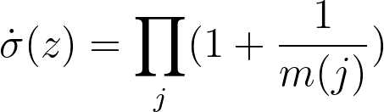
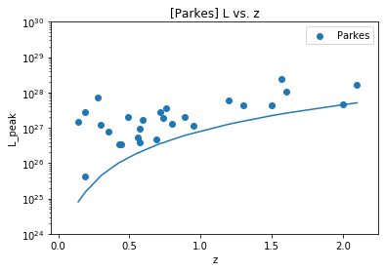
Determining
Where j is all the FRBs < z
m(j) is the number of FRBs in the associated set with L > L_lim and z < z_j

Slide 3
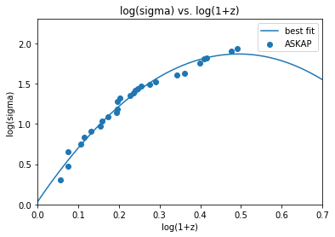
(cont.)
Using a 2nd degree polynomial fit
a = -7.50444804
b = 7.41720043
c = 0.03419661
for log(sigma) = a(log(1+z))^2 + b(log(1+z)) + c
Is it better to use a higher order fit, or perhaps a different analytical function?

Slide 4

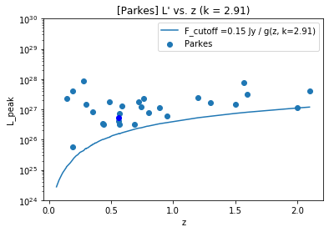
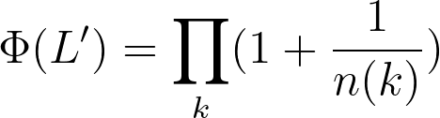
Determining
Using the k value for tau = 0, I transformed L to the “local” values of L’. Then, I used the following formula:
where k is all the FRBs with local luminosity > L’
n(k) is the number of FRBs in the associated set with respect to z

Slide 5
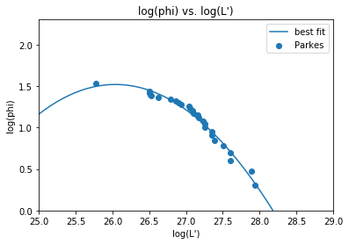
(cont.)
Using a 2nd degree polynomial fit
a = -0.33119575
b = 17.24837765
c = -223.0512902

Slide 6
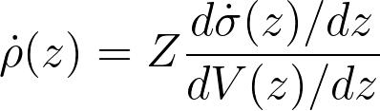
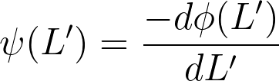
Still working on:
Determination of \dot{\rho}(z) and \psi(L’) using the derivatives of the fitted polynomials
\Psi(L, z) can be determined using the previously determined functions.

Slide 7
Questions
How is the formula on the right (formula #1) used? I was under the impression that (2) gave an expression for \dot{\sigma}(z).
How do you determine \Psi(Lmin) based on the L-Lmin graph? I did not encounter a procedure in the papers talking about this.
(1)
(2)

